Slide 1
Day 1 – Course Overview

Slide 2




Quick Overview
Part 1 – Fundamental
Part 2 – Intermediate
Part 3 – Advance
Part 4 - Professional

Slide 3
Getting Started
JavaScript Fundamental
React Fundamental
Deep Dives
Fundamental Practices
Authentication
NextJS
Typescript
More ……
Forms
Redux
Routing
Performance
React Query
Context API
API Request
Optimization
Hooks
Tailwind CSS / Styling
Debugging
Side Effect

Slide 4
Consideration – Part 1
Code along with me.
Don’t worry about BTS (why and how???) or best practices
Take a break, review the code, review notes, review project we built
Let’s have fun. If burnout!!!!! STOP and COME BACK later.

Slide 5
Consideration – Part 2
Slow me down or speed me up
Practice… Practice… Practice…
Coding Exercise, Challenges, Quiz and Build Mini Project on your own
Help Each other !!!!!!!!

Slide 6
What is REACT?
JavaScript Library for user interface.
Let's simplify it more: “Popular, Declarative, Component-based, State-Driven JavaScript Library for user interface developed by Facebook”

Slide 7
React JS v/s Vanilla JavaScript
Using “Just JavaScript” is not a great option.
Writing complex code quickly becomes cumbersome.
Complex JS code quickly becomes error-prone.
Complex JS code often is hard to maintain or edit.
React offers a simpler mental model

Slide 8
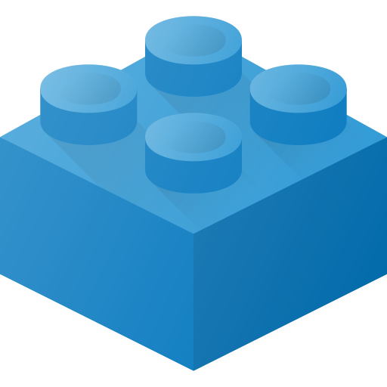
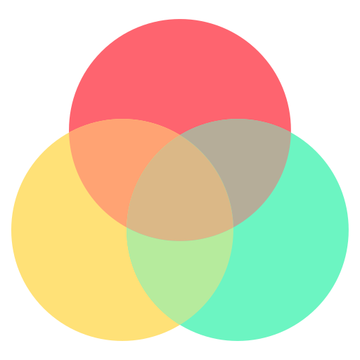



Component-Based
Building blocks like LEGO of UI in React.
App build by building and combining multiple components.

Slide 9
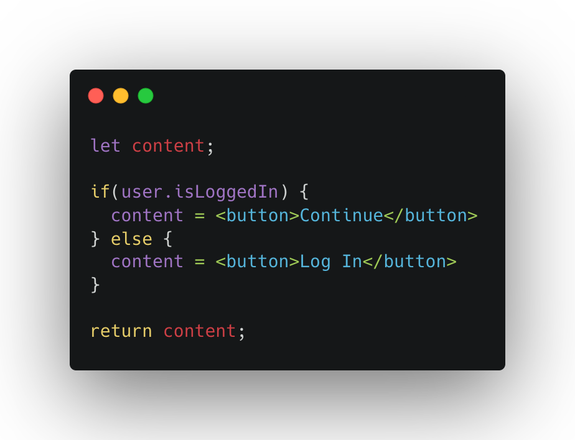
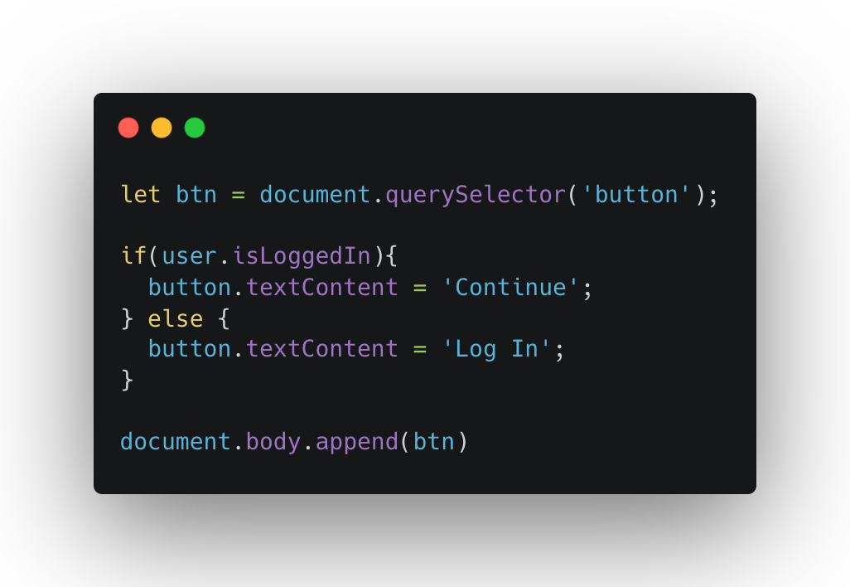
Declarative VS Imperative
Define the goal, not the steps
Define the steps, not the goal
Notes:
React: Declarative UI Programming
With react, you define the target UI states, not the steps to get there! Instead, React will figure out and perform the necessary steps

Slide 10
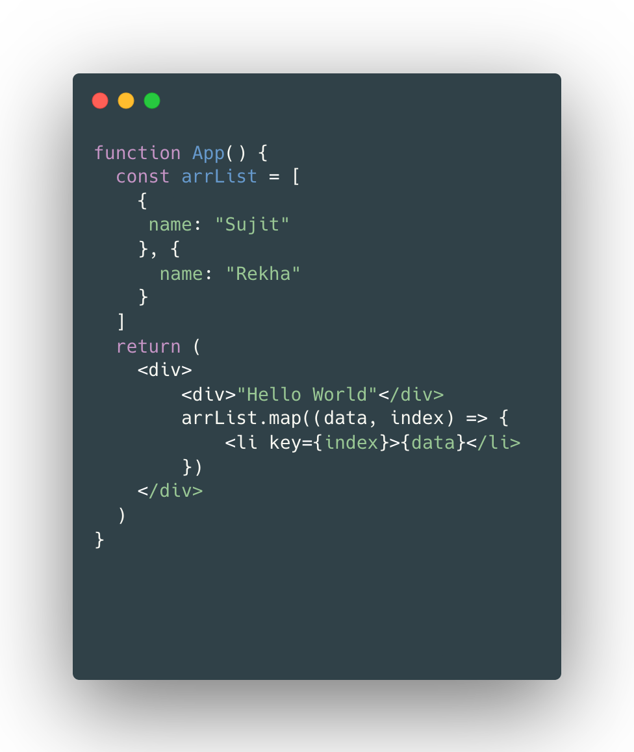
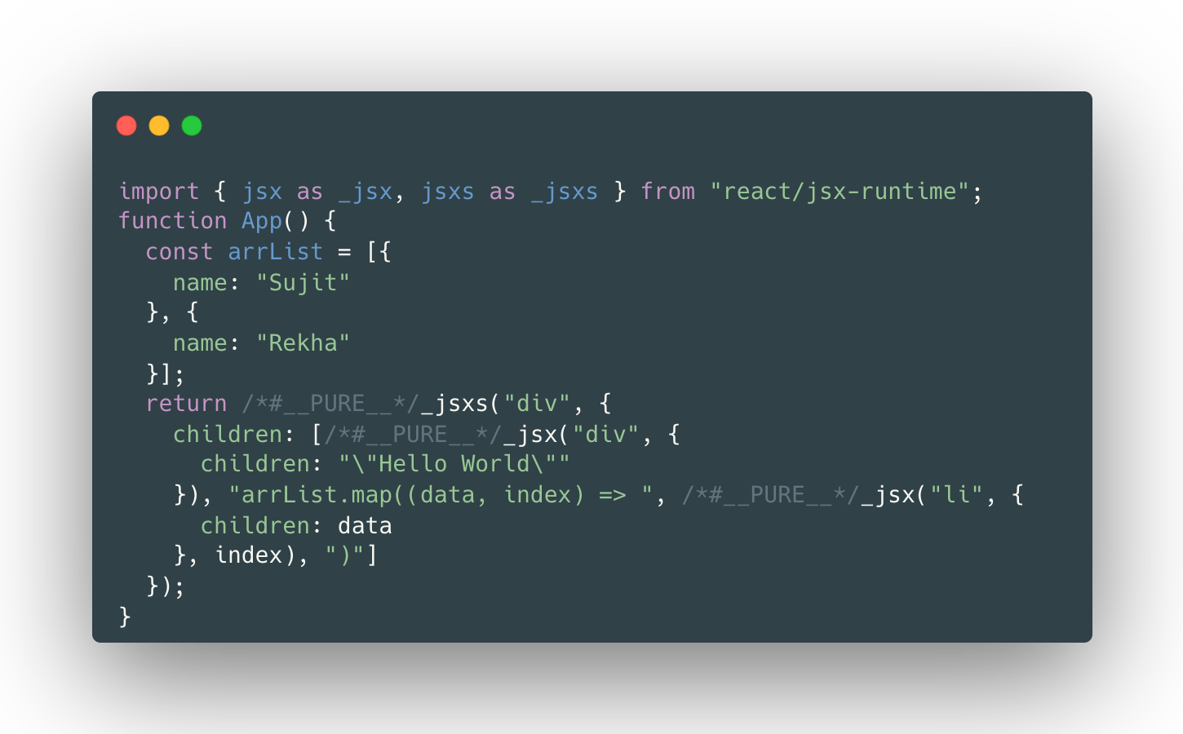
React Code Must be Transformed - BabelJS

Slide 11
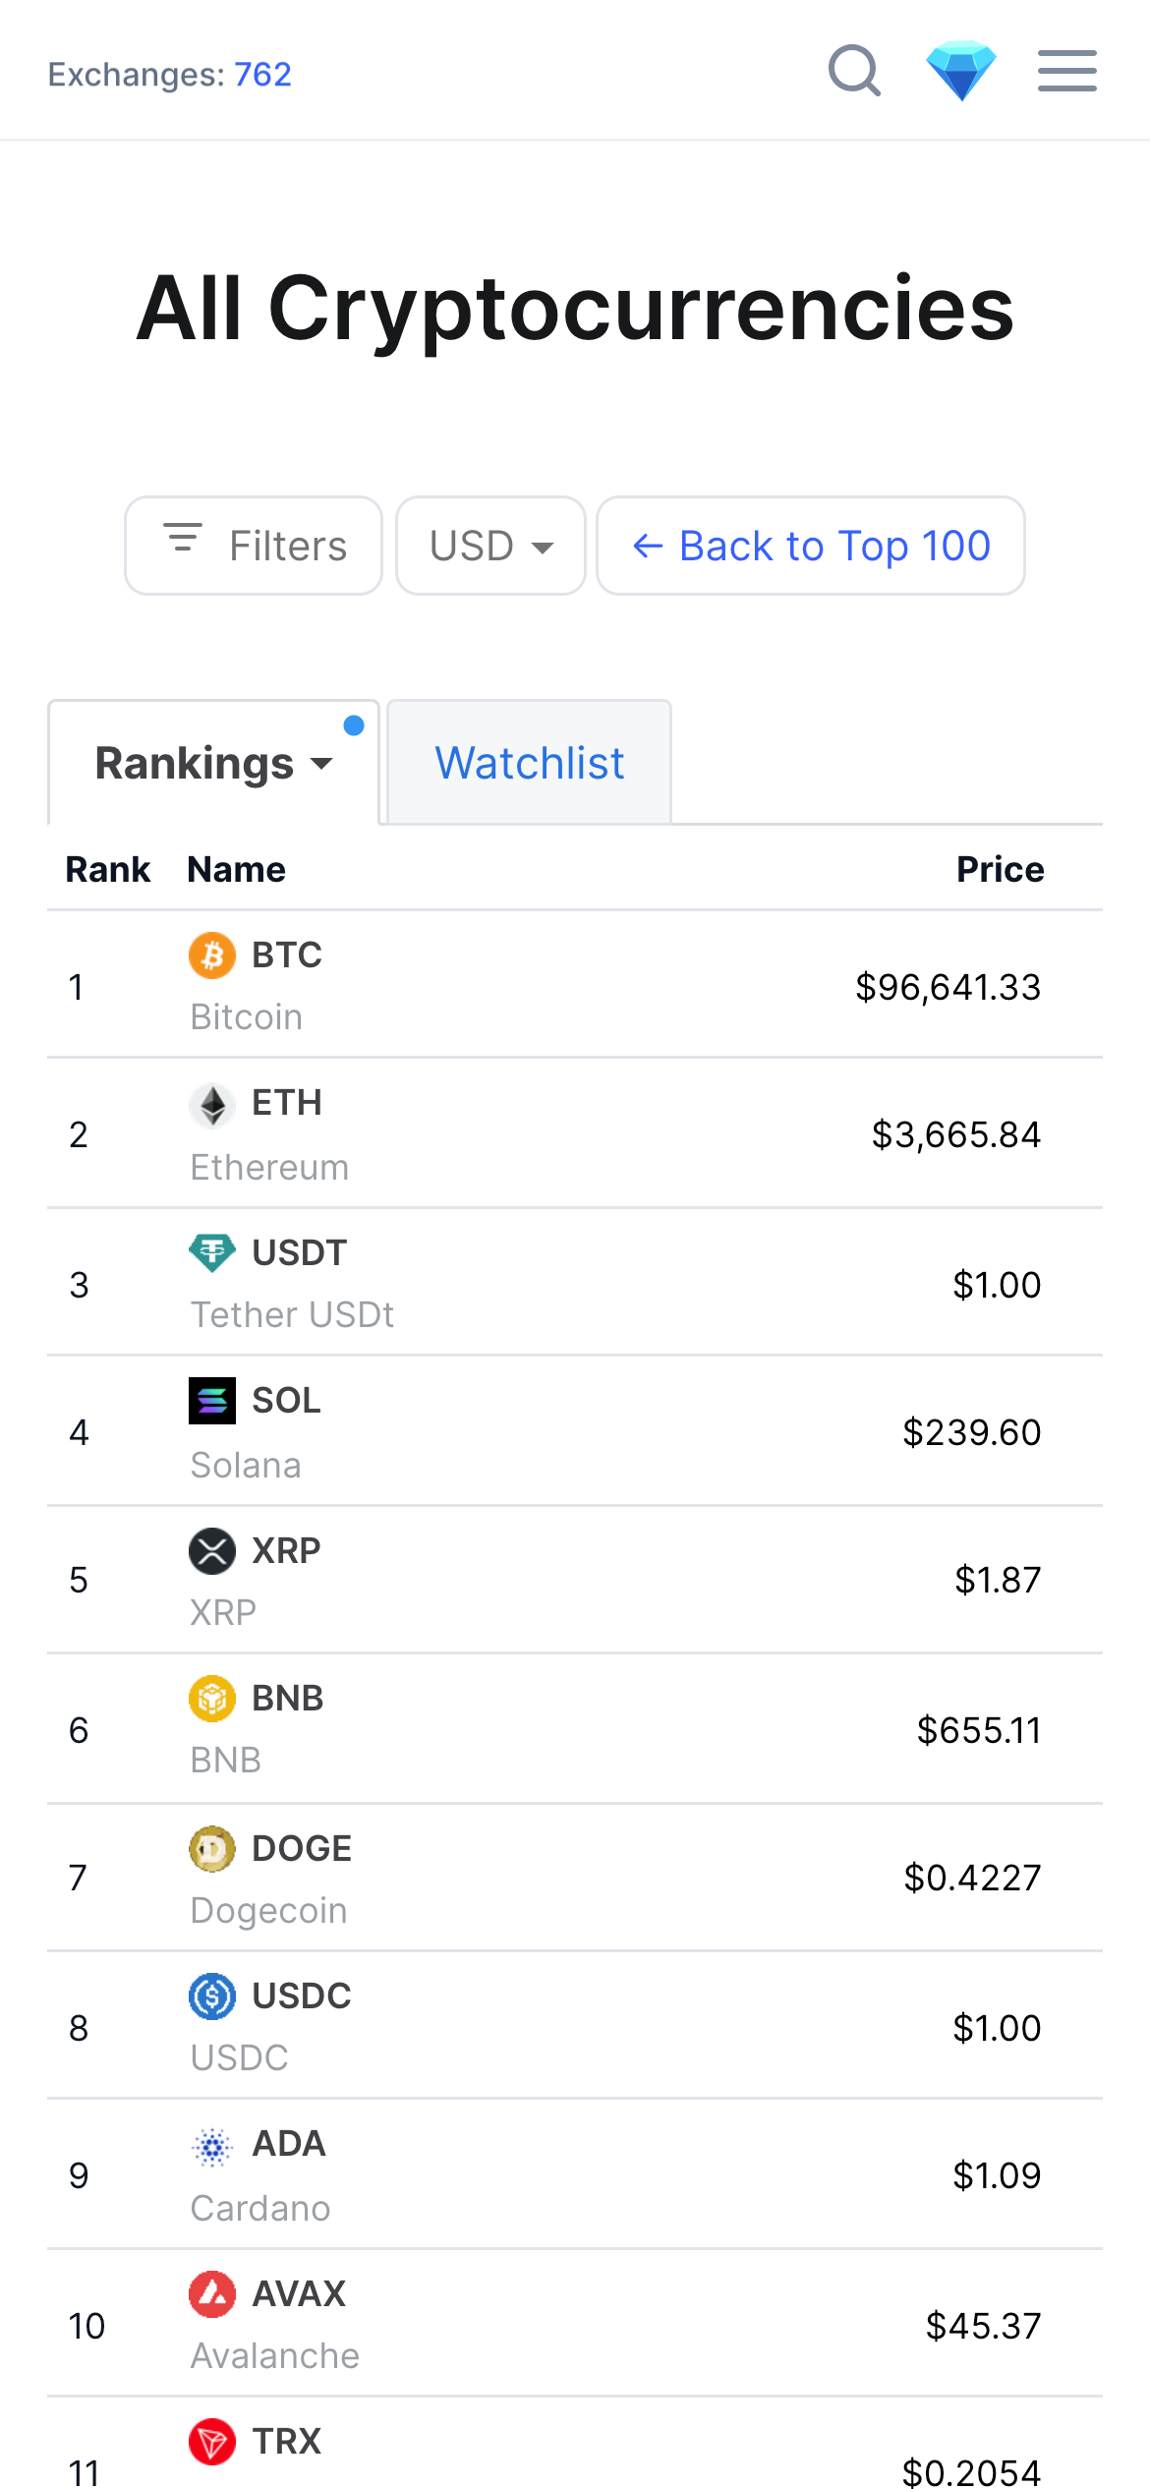
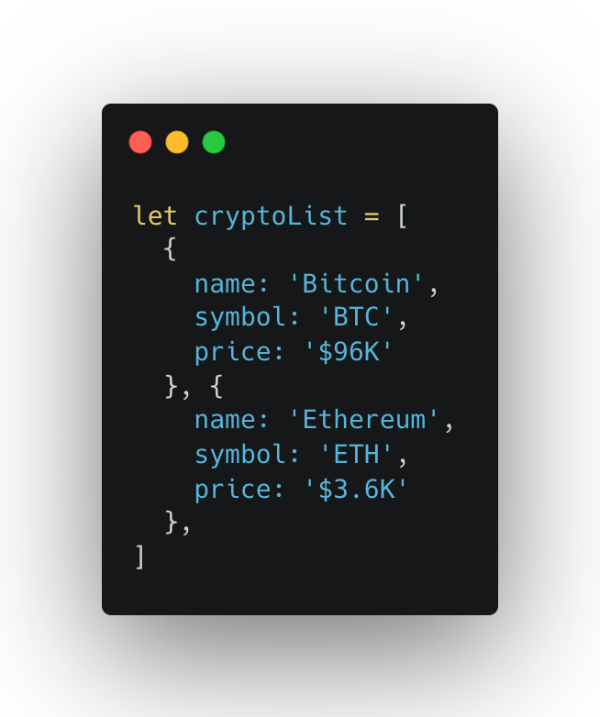

State-Driven
Sync UI with Data
React reacts to state changes by re-rendering the UI
1
4
3
2

Slide 12


Library or Framework ????
View layer only.
Need to pick multiple external library to build a complete application
Notes:
Routing, data fetching, SSR
React team now advices

Slide 13







Extremely Popular
Hugh job market
React developer community

Slide 14
Created by Facebook
2011, Jordan Walke
2013, Open Source

Slide 15


Setting up a new react project
Create-react-app
Starter-kit
Already configured
Slow and outdated technologies
Use for learning purpose
Don’t use for a real-world project
Vite
Modern real-world project
Modern build tool that contains a template for setting up React app
Need to manually setup Eslint (and others)
Extremely fast, hot module replacement (HMR) and bundling

Slide 16




Setting up development Environment
Vscode (https://code.visualstudio.com/)
Brave (https://brave.com/)
NodeJS (https://nodejs.org/en)

Slide 17
Summary
Rendering Components on a webpage (UI) based on their current state.
Keeping the UI in sync with state, by re-rendering when state change.

Slide 18
Feedback
What went well?
What went wrong?
What did you learn?

Slide 19
I believe that you learn the most if you don’t learn alone but find learning partners and other people with similar interest. - Unknown

